Slide 1
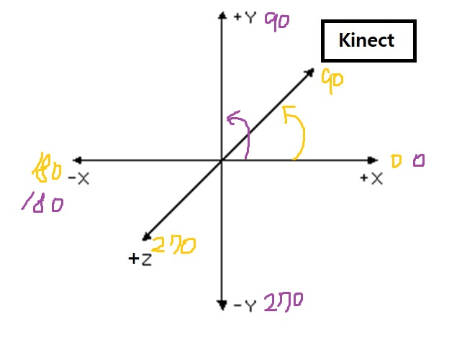
Math.Atan2 :
매개변수 : y포인터 , x포인터
리턴 값 : -pi ~ +pi
반환받은 Radian값을 일반 각도 값으로 변환
음수 값이 반환 되는 경우
리턴 값+360 처리하여
0~360 도 사이의 각도값 반환
예시 :
if (Head_Neck_xy < 0)
{
Head_Neck_xy += 360;
}
if (Head_Neck_xz < 0)
{
Head_Neck_xz += 360;
}

Slide 2
Head
1
Neck
ShoulderLeft
ShoulderRight
2
3
ElbowLeft
6
ElbowRight
4
5
WristLeft
SpineBase
WristRight
7
8
KneeLeft
KneeRight
9
10
AnkleLeft
AnkleRight

Slide 3
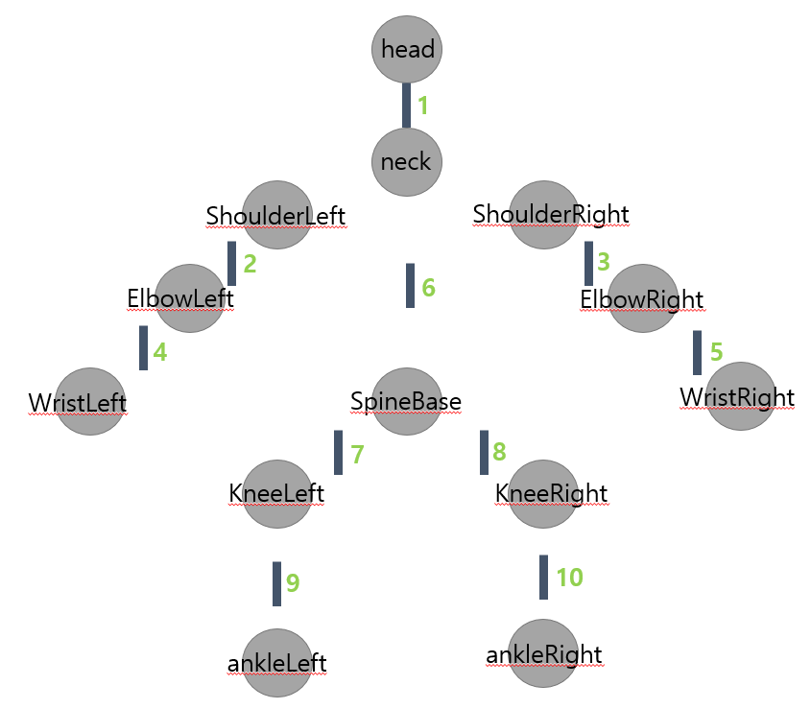
[1]head-Neck
double Head_Neck_xy=Math.Atan2(Head_y - Neck_y, Head_x - Neck_x) * (180.0 / Math.PI);
double Head_Neck_xz=-Math.Atan2(Head_z - Neck_z, Head_x - Neck_x) * (180.0 / Math.PI);

Slide 4
[2]ShoulderLeft-elbowLeft
double ElbowLeft_ShoulderLeft_xy = Math.Atan2(ElbowLeft_y-ShoulderLeft_y,ElbowLeft_x-ShoulderLeft_x) * (180.0 / Math.PI);
double ElbowLeft_ShoulderLeft_xz = -Math.Atan2(ElbowLeft_z - ShoulderLeft_z, ElbowLeft_x - ShoulderLeft_x) * (180.0 / Math.PI);

Slide 5
[3]ShoulderRight-ElbowRight
double ShoulderRight_ElbowRight_xy = Math.Atan2(ElbowRight_y-ShoulderRight_y, ElbowRight_x-ShoulderRight_x) * (180.0 / Math.PI);
double ShoulderRight_ElbowRight_xz = -Math.Atan2(ElbowRight_z - ShoulderRight_z, ElbowRight_x - ShoulderRight_x) * (180.0 / Math.PI);

Slide 6
[4]ElbowLeft-WristLeft
double ElbowLeft_WristLeft_xy = Math.Atan2(WristLeft_y - ElbowLeft_y, WristLeft_x-ElbowLeft_x) * (180.0 / Math.PI); double ElbowLeft_WristLeft_xz = -Math.Atan2(WristLeft_z-ElbowLeft_z, WristLeft_x-ElbowLeft_x) * (180.0 / Math.PI);

Slide 7
[5]ElbowRight-WristRight
double ElbowRight_WristRight_xy = Math.Atan2(WristRight_y-ElbowRight_y, WristRight_x-ElbowRight_x) * (180.0 / Math.PI); double ElbowRight_WristRight_xz = -Math.Atan2(WristRight_z-ElbowRight_z, WristRight_x-ElbowRight_x) * (180.0 / Math.PI);

Slide 8
[6]Neck-SpineBase
double Neck_SpineBase_xy = Math.Atan2(Neck_y - SpineBase_y, Neck_x - SpineBase_x) * (180.0 / Math.PI); double Neck_SpineBase_xz = -Math.Atan2(Neck_z - SpineBase_z, Neck_x - SpineBase_x) * (180.0 / Math.PI);

Slide 9
[7]SpineBase-KneeLeft
double SpineBase_KneeLeft_xy = Math.Atan2(KneeLeft_y-SpineBase_y, KneeLeft_x-SpineBase_x) * (180.0 / Math.PI);
double SpineBase_KneeLeft_xz = -Math.Atan2(KneeLeft_z-SpineBase_z, KneeLeft_x-SpineBase_x) * (180.0 / Math.PI);

Slide 10
[8]SpineBase-KneeRight
double SpineBase_KneeRight_xy = Math.Atan2(KneeRight_y-SpineBase_y, KneeRight_x-SpineBase_x) * (180.0 / Math.PI);
double SpineBase_KneeRightt_xz = -Math.Atan2(KneeRight_z-SpineBase_z, KneeRight_x-SpineBase_x) * (180.0 / Math.PI);

Slide 11
[9]KneeLeft-AnkleLeft
double KneeLeft_AnkleLeft_xy = Math.Atan2(AnkleLeft_y-KneeLeft_y, AnkleLeft_x-KneeLeft_x) * (180.0 / Math.PI);
double KneeLeft_AnkleLeft_xz = -Math.Atan2(AnkleLeft_z-KneeLeft_z, AnkleLeft_x-KneeLeft_x) * (180.0 / Math.PI);

Slide 12
[10]KneeRight-AnkleRight
double KneeRight_AnkleRight_xy = Math.Atan2(AnkleRight_y - KneeRight_y, AnkleRight_x - KneeRight_x) * (180.0 / Math.PI); double KneeRight_AnkleRight_xz = -Math.Atan2(AnkleRight_z - KneeRight_z, AnkleRight_x - KneeRight_x) * (180.0 / Math.PI);

